Slide 1
Modeling Cyberphysical Systems
Sayan Mitra
Verifying cyberphysical systems
mitras@illinois.edu

Slide 2
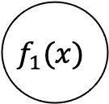
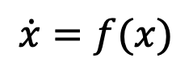
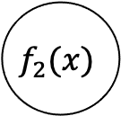
Map of CPS models
Dynamical systems
Differential inclusions
Discrete transition systems, automata
Markov chains
Probabilistic automata, Markov decision processes (MDP)
Continuous time, continuous state MDPs
+
$$\dot{x}=f(x)$$
1
2
Hybrid systems
$$f_{1}(x)$$
$$f_{2}(x)$$
Stochastic Hybrid systems

Slide 3
Outline
Hybrid automata
Executions
Urgency
Zeno
Hybrid stability

Slide 4
Thermostat automaton
automaton Thermostat(u, l, K, h : Real) where u > l
type Status enumeration [on, off ] actions
turnOn; turnOff;
variables
x: Real := l loc: Status := on
transitions
turnOn
pre x≤l ∧ loc=off
eff loc := on
trajectories
modeOn
evolve d(x) = K(h − x)
invariant loc = on ∧ x ≤ u
turnOff
pre x≥u ∧ loc=on
eff loc := off
modeOff
evolve d(x) = −Kx
invariant loc = off ∧ x ≥ l
Determinism vs nondeterminism
mode invariants

Slide 5
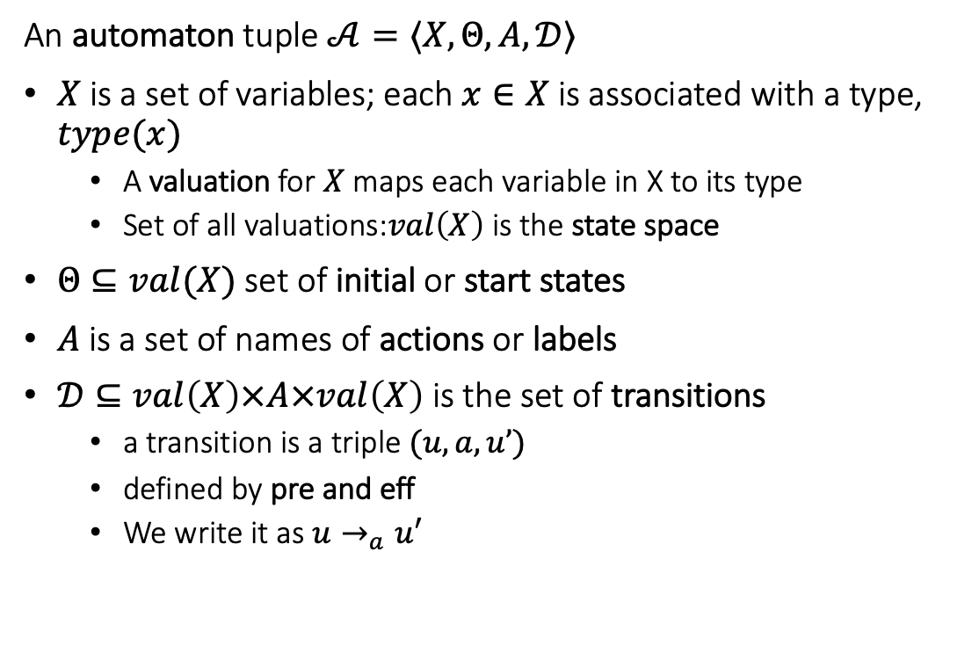
Recall from Lecture 1. language for automata
An automaton tuple $𝒜=〈X,Θ, A, 𝒟〉$
$X$ is a set of variables; each $x∈X$is associated with a type, $type(x)$
A valuation for $X$ maps each variable in X to its type
Set of all valuations:$val\left(X\right)$ is the state space
$Θ⊆val(X)$ set of initial or start states
$A$ is a set of names of actions or labels
$𝒟⊆val\left(X\right)×A×val\left(X\right)$ is the set of transitions
a transition is a triple $(u,a,u’)$
defined by pre and eff
We write it as $u→_{a}u′$
automaton DijkstraTR(N:Nat, K:Nat), where K > N
type ID: enumeration [0,...,N-1]
type Val: enumeration [0,...,K]
actions
update(i:ID)
variables
x:[ID -> Val]
transitions
update(i:ID)
pre i = 0 /\ x[i] = x[N-1]
eff x[i] := (x[i] + 1) % K
update(i:ID)
pre i >0 /\ x[i] ~= x[i-1]
eff x[i] := x[i-1]

Slide 6
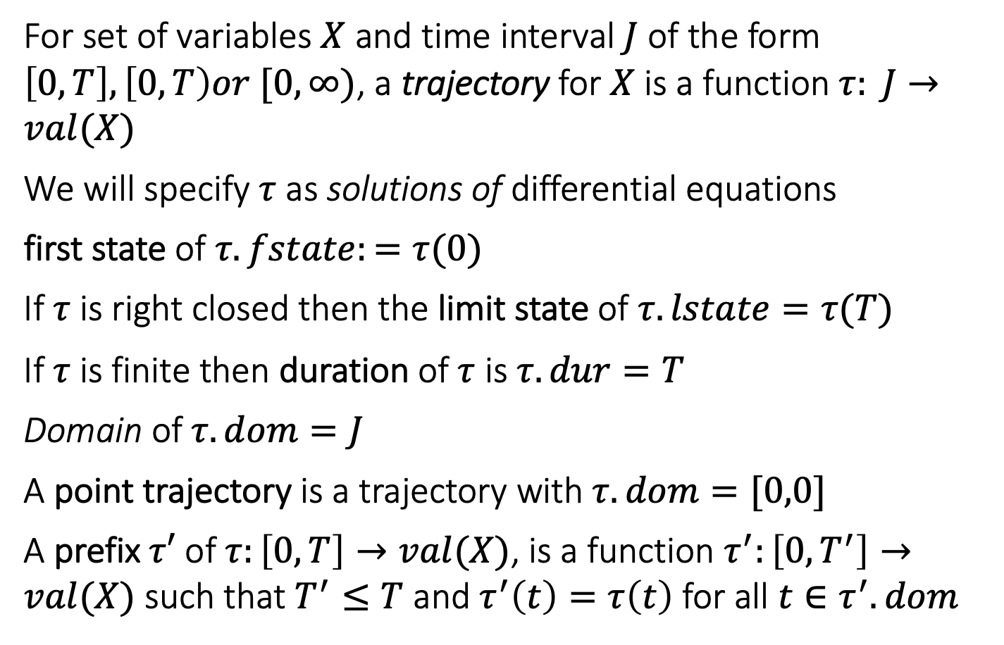
Trajectories
For set of variables $X$ and time interval $J$ of the form $\left[0,T\right], \left[0,T\right)or [0,∞)$, a trajectory for $X$ is a function $τ: J→val(X)$
We will specify $τ$ as solutions of differential equations
first state of $τ.fstate:=τ(0)$
If $τ$ is right closed then the limit state of $τ.lstate=τ(T)$
If $τ$ is finite then duration of $τ$ is $τ.dur=T$
Domain of $τ.dom=J$
A point trajectory is a trajectory with $τ.dom=[0,0]$
A prefix $τ′$ of $τ:\left[0,T\right]→val(X)$, is a function $τ^{′}:\left[0,T^{′}\right]→val(X)$ such that $T^{′}≤T$ and $τ^{′}\left(t\right)=τ\left(t\right)$ for all $t∈τ^{′}.dom$

Slide 7
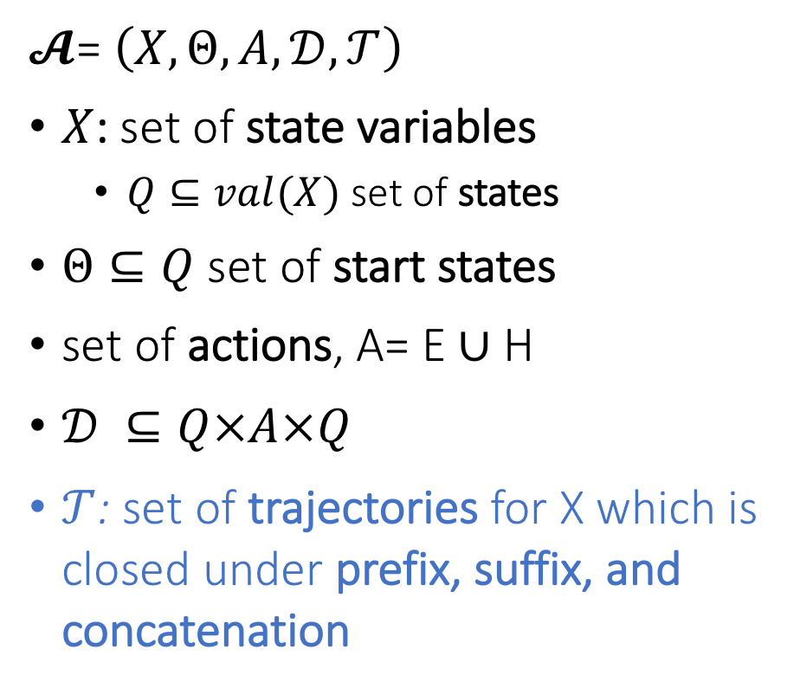
Hybrid Automaton
$𝓐$= $\left(X,Θ,A,𝒟,𝒯\right)$
$X$: set of state variables
$Q⊆val(X)$ set of states
$Θ⊆Q$ set of start states
set of actions, A= E ∪ H
$𝒟 ⊆Q×A×Q$
$𝒯$: set of trajectories for X which is closed under prefix, suffix, and concatenation
Notes:
Pick a couple of nice examples

Slide 8
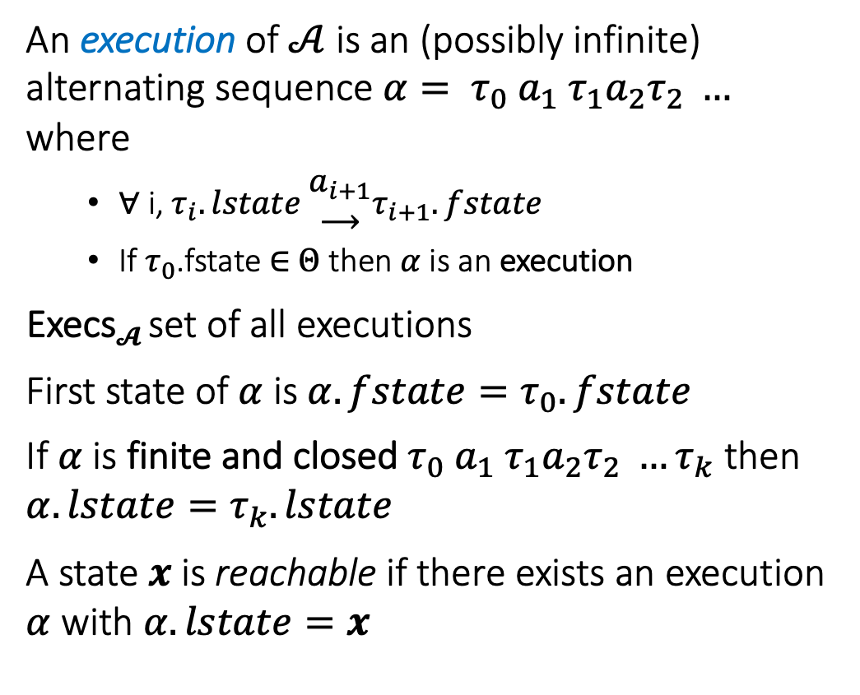
Semantics: Executions and Traces
An execution of $𝒜$ is an (possibly infinite) alternating sequence $α= τ_{0} a_{1} τ_{1}a_{2}τ_{2} …$ where
∀ i, $τ_{i}.lstate \begin{matrix}a_{i+1} \\ ⟶\end{matrix}τ_{i+1}.fstate$
If $τ_{0}$.fstate ∈ $Θ$ then $α$is an execution
Execs$𝓐$ set of all executions
First state of $α$ is $α.fstate=τ_{0}.fstate$
If $α$is finite and closed $τ_{0} a_{1} τ_{1}a_{2}τ_{2} …τ_{k}$ then $α.lstate=τ_{k}.lstate$
A state $x$is reachable if there exists an execution $α$ with $α.lstate=x$

Slide 9
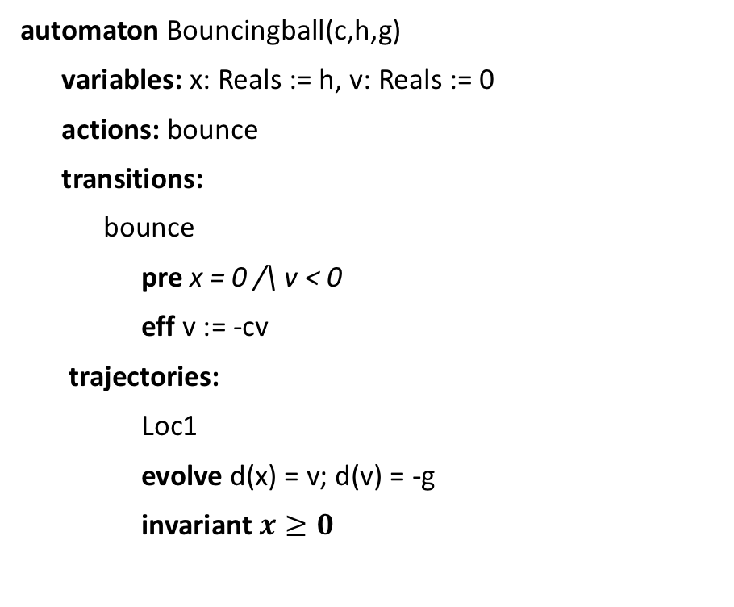
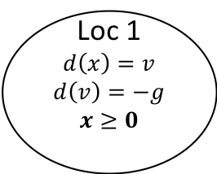
Bouncing Ball
automaton Bouncingball(c,h,g)
variables: x: Reals := h, v: Reals := 0
actions: bounce
transitions:
bounce
pre x = 0 /\ v < 0
eff v := -cv
trajectories:
Loc1
evolve d(x) = v; d(v) = -g
invariant $x≥0$
bounce
x = 0 /\ v < 0
v’ := -cv
Loc 1
$$d\left(x\right)=v$$
$$d\left(v\right)=−g$$
$$x≥0$$
x:= h
mode invariant, not to be confused with invariants of the automaton
Graphical Representation used in many articles
Notes:
Guard, Precondition
Effect, Reset map
Invariance

Slide 10
Urgency: Must transitions
automaton Thermostat(u, l, K, h,d : Real) where u > l
type Status enumeration [on, off ] actions
turnOn; turnOff;
variables
x: Real := l loc: Status := on
transitions
turnOn
pre x≤l ∧ loc=off
eff loc := on
trajectories
modeOn
evolve d(x) = K(h − x)
invariant loc = on ∧ x ≤ u + d
turnOff
pre x≥u ∧ loc=on
eff loc := off
modeOff
evolve d(x) = −Kx
invariant loc = off ∧ x ≥ l - d
An urgent transition (or action) is an action that has to occur as soon as it is enabled
Our language does have special syntax for creating urgent transitions, but we can use mode invariants to accomplish this

Slide 11
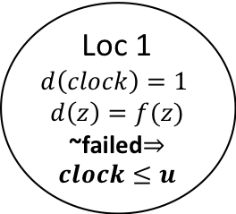
Another Example: Periodically Sending Process
Automaton PeriodicSend(u)
variables: analog
clock: Reals := 0, z:Reals, failed:Boolean := F
actions: send(m:Reals), fail
transitions:
send(m)
pre clock = u /\ m = z /\ ~failed
eff clock := 0
fail
pre true
eff failed := T
trajectories:
evolve d(clock) = 1, d(z) = f(z)
invariant failed \/ clock<=u
send(m)
clock = u /\ m = z /\ ~failed
clock := 0
Loc 1
$$d\left(clock\right)=1$$
$$d\left(z\right)=f(z)$$
~failed$⇒clock≤u$
clock:= 0
fail
true
failed := T

Slide 12


Zeno’s Paradox
Achilles, the fastest athlete, greatest warrior
Zeno, Greek philosopher
whatever!
You couldn’t even beat a turtle
Achilles runs 10 times faster than than the tortoise, but the turtle gets to start 1 second earlier. Can Achilles ever catch Turtle?
Lesson: Mixing discrete transitions with continuous motion can be tricky!
After 1/10th of a second, Achilles reaches where the Turtle (T) started, and T has a head start of 1/10th second.
After another 1/100th of a second, A catches up to where T was at t=1/10 sec, but T has a head start of 1/100th
…
T is always ahead …
Notes:
5 mins.

Slide 13
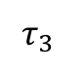
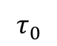
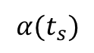
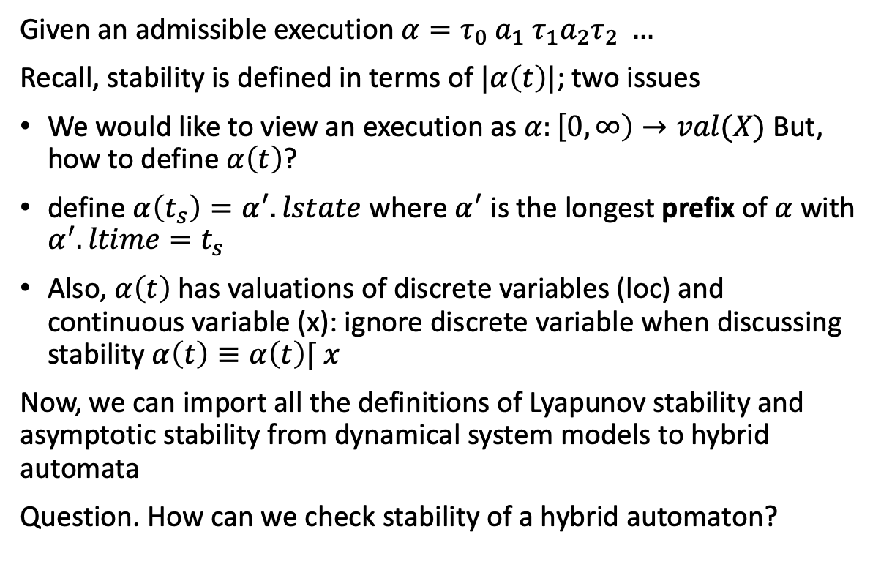
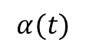
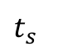
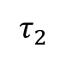

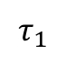
Defining stability of hybrid automata
$$α(t_{s})$$
$$τ_{3}$$
Given an admissible execution $α=τ_{0} a_{1} τ_{1}a_{2}τ_{2} …$
Recall, stability is defined in terms of $|α\left(t\right)|$; two issues
We would like to view an execution as $α:\left[0,∞\right)→val(X)$ But, how to define $α\left(t\right)$?
define $α\left(t_{s}\right)=α^{′}.lstate$ where $α^{′}$ is the longest prefix of $α$ with $α^{′}.ltime=t_{s}$
Also, $α\left(t\right)$ has valuations of discrete variables (loc) and continuous variable (x): ignore discrete variable when discussing stability $α\left(t\right)≡α\left(t\right)⌈ x$
Now, we can import all the definitions of Lyapunov stability and asymptotic stability from dynamical system models to hybrid automata
Question. How can we check stability of a hybrid automaton?
$$τ_{2}$$
$$τ_{1}$$
$$α(t)$$
$$τ_{0}$$
$t_{s}$
time

Slide 14
Stability of a hybrid automaton
Each of the modes of a walking robot are asymptotically stable
Is it possible to switch between them to make the system unstable?
Walk
Run

Slide 15
Yes! By switching between them the system becomes unstable
Walk
Run
Notes:
So, 300 years of mathematics developed for analyzing physics will not be enough for analyzing systems like self-driving cars where computers switch between different physics

Slide 16
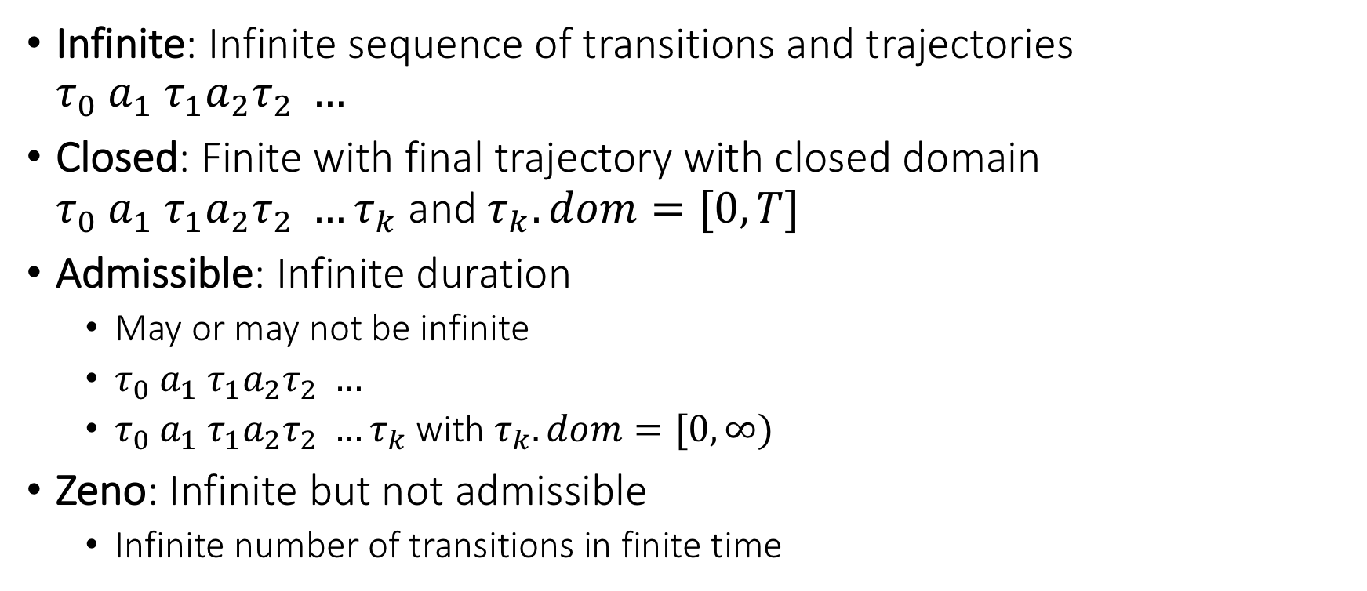
Special kinds of executions
Infinite: Infinite sequence of transitions and trajectories $τ_{0} a_{1} τ_{1}a_{2}τ_{2} …$
Closed: Finite with final trajectory with closed domain $τ_{0} a_{1} τ_{1}a_{2}τ_{2} …τ_{k}$ and $τ_{k}.dom=[0,T]$
Admissible: Infinite duration
May or may not be infinite
$τ_{0} a_{1} τ_{1}a_{2}τ_{2} …$
$τ_{0} a_{1} τ_{1}a_{2}τ_{2} …τ_{k}$ with $τ_{k}.dom=[0,∞)$
Zeno: Infinite but not admissible
Infinite number of transitions in finite time

Slide 17
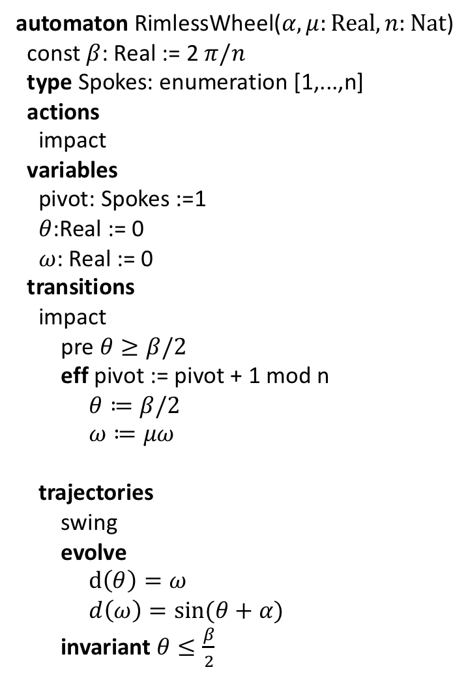
Rimless wheel
automaton RimlessWheel($α,μ:Real, n:Nat$)
const $β$: Real := 2 $π/n$
type Spokes: enumeration [1,...,n]
actions
impact
variables
pivot: Spokes :=1
$θ$:Real := 0
$ω$: Real := 0
transitions
impact
pre $θ≥β/2$
eff pivot := pivot + 1 mod n
$θ≔β/2$
$ω≔μω$
trajectories
swing
evolve
$d\left(θ\right)=ω$
$d\left(ω\right)=\sin{(θ+α)}$
invariant $θ≤\frac{β}{2}$

Slide 18
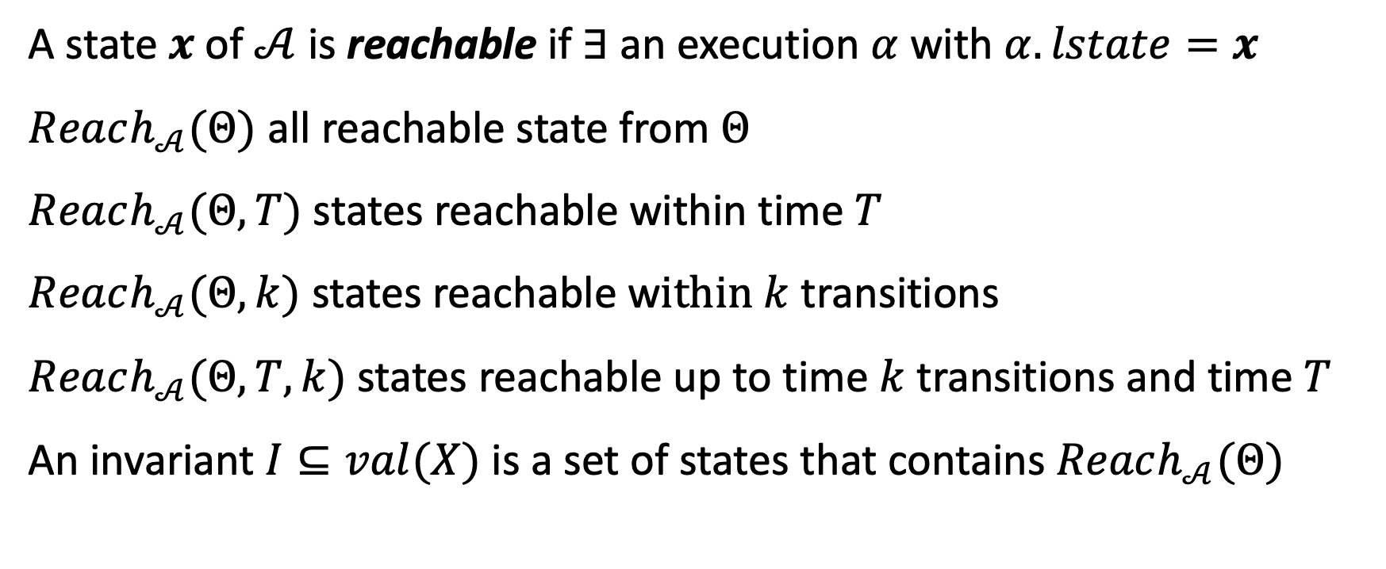
Invariants and reachability
A state $x$of $𝒜$ is reachable if $∃$ an execution $α$ with $α.lstate=x$
$Reach_{𝒜}(Θ)$ all reachable state from $Θ$
$Reach_{𝒜}(Θ,T)$ states reachable within time $T$
$Reach_{𝒜}(Θ,k)$ states reachable w$ithin k$ transitions
$Reach_{𝒜}(Θ,T,k)$ states reachable up to time $k$ transitions and time $T$
An invariant $I⊆val(X)$ is a set of states that contains $Reach_{𝒜}(Θ)$

Slide 19
Summary: Things to watch out for in hybrid models
Continuous time and discrete transitions
May/Must conditions for transitions; urgency
Zeno phenomena
Instability arising from switches

